Slide 1
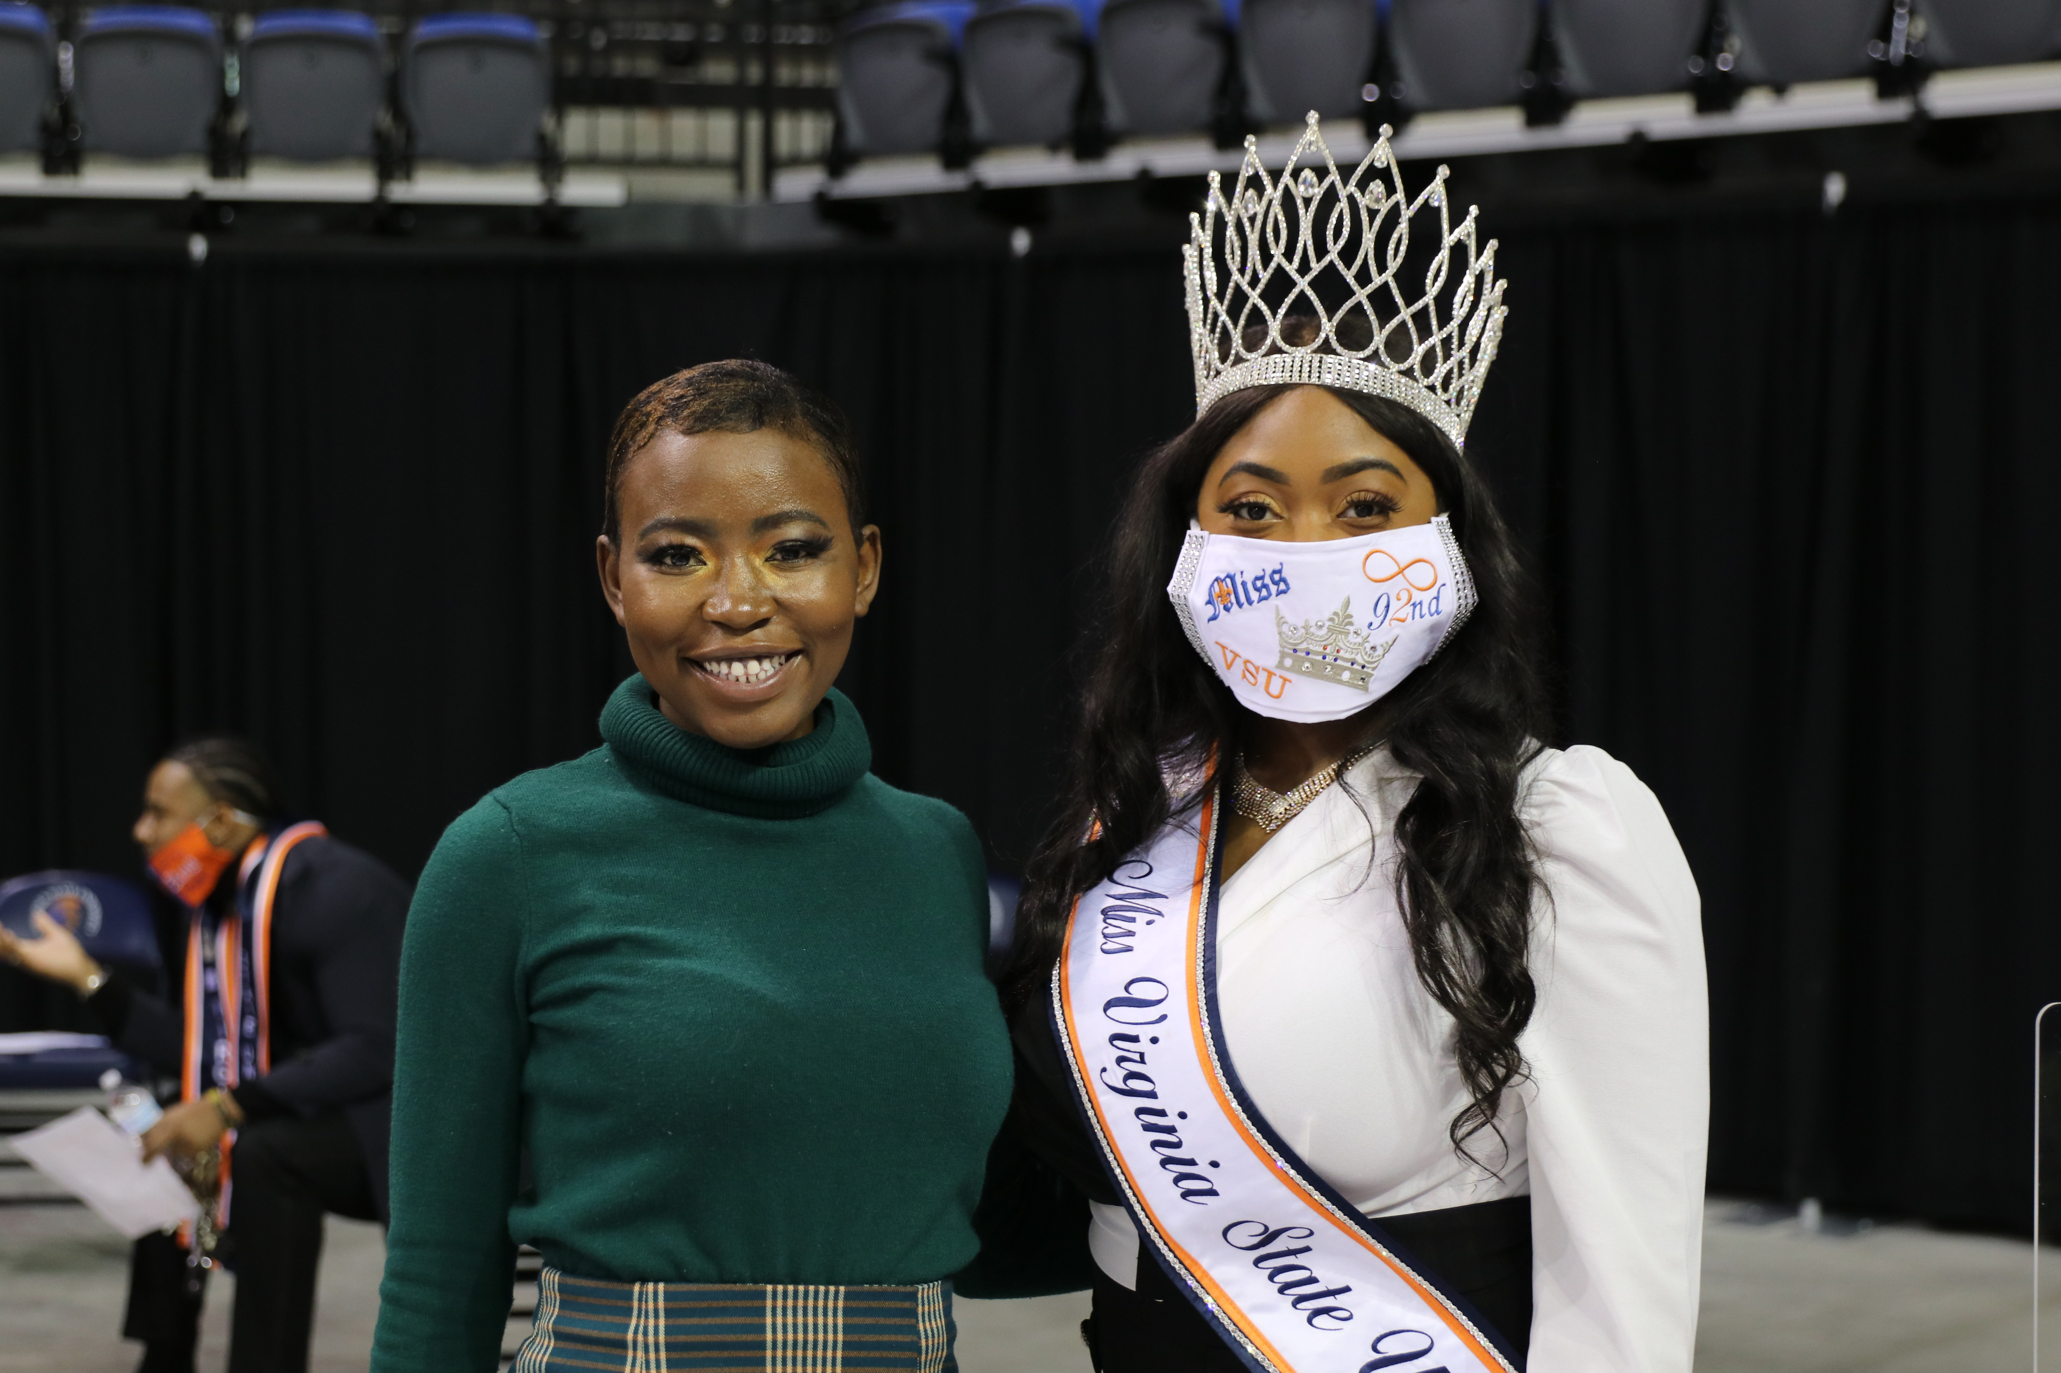
Institutional Advancement Update Tonya S. Hall, Vice President for External Relations

Slide 2
IA Fundraising Dashboard Report FY21
 | Fiscal Year 2021 | Fiscal Year 2020
CHARITABLE | $2,101,827.39 | $1,441,502.06
NON-CHARITABLE | $116,601.63 | $158,624.28
TOTAL DOLLARS | $2,218,429.02 | $1,600,126.34
TOTAL DONORS | 1,953 | 1,728
Alumni & Alumni Association | $803,882.27 1,564 | $812,165.35 1,293
Faculty & Staff | $87,791.79 71 | $73,436.38 99
Corporations, Foundations & Organizations | $1,086,862.22 65 | $419,008.76 112
Priority 5: Increase and Diversity Financial Resources and Enhance Operational Effectiveness
As of January 18, 2021

Slide 3
https://www.vsu.edu/news/2020/vsu-receives-30-million-gift.php

Slide 4
National Day of Giving
December 3, 2019 | December 1, 2020
$34,519 | $58,824

Slide 5
Prospects in the Pipeline
Smithfield Foods
Bank of America Bloomberg Philanthropies
Carmax
Markel

Slide 6
Implementation of Donor Giving Platform
Donor Giving Platform
Event Management
Social Network Integration
Email Marketing
Completion: July 2021

Slide 7
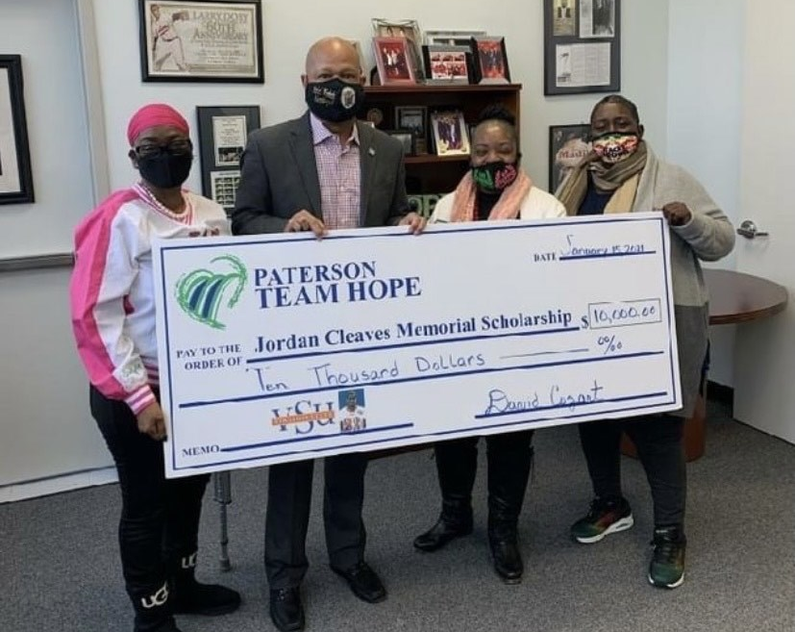
VSU thanks Paterson Team Hope for their gift of $10,000 towards the Jordan Cleaves Memorial Scholarship Fund designated for students attending VSU from the state of New Jersey. The fund was created in memory of VSU student and New Jersey native Jordan Cleaves.
Mission Moment

Slide 8
UPCOMING EVENTS
February 23 - 27, 2021 CIAA Virtual Vibe Tournament
March 18, 2021
Founders Day May 22, 2021
Alumni Weekend
May 22, 2021
Commencement
October 23, 2021
Homecoming

Slide 9
CONTACT INFO Tonya S. Hall tshall@vsu.edu 804-868-5883

